Slide 1

Chicagoland and Gentrification
April 2018
Stephen Monteiro
Brickey LeQuire
Amelia Deschenes
Notes:
Introductions of ourselves

Slide 2


Exploring of the Factors of Gentrification
How does the demographic makeup of a neighborhood change as it becomes gentrified?
How are crime rates impacted in gentrified neighborhoods?
Notes:
Background on CCAs and Gentrification Index

Slide 3
Data Sources
UIC Gentrification Index.csv
The Socioeconomic Change of Chicago’s Community Areas (1970-2010) shows that inequality is growing in Chicago. Some neighborhoods have grown wealthier, while others have grown poorer. At the same time, the number of middle-class neighborhoods has gone down.
CMAP Data Hub Community Snapshots
These summarize demographics, housing, employment, transportation habits, retail sales, property values, and land use in metropolitan Chicago's seven counties, 284 municipalities, and 77 Chicago Community Areas.
Chicago City Data.api
This dataset reflects reported incidents of crime (with the exception of murders where data exists for each victim) that occurred in the City of Chicago from 2001 to present, minus the most recent seven days.Data is extracted from the Chicago Police Department's CLEAR (Citizen Law Enforcement Analysis and Reporting) system
Notes:
Background on CCAs and Gentrification Index

Slide 4
Classification
Extreme Poverty
Gentrification
Middle Class
Mild Decline
Moderate Decline
Not Gentrification
Poverty
Serious Decline
Upper Class
Gentrified | Not Gentrified
Lake View | Armour Square | Garfield Ridge | North Park
Lincoln Park | Beverly | Hyde Park | Norwood Park
Loop | Bridgeport | Irving Park | Portage Park
Near North Side | Calumet Heights | Jefferson Park | West Ridge
Near South Side | Clearing | Kenwood
Near West Side | Dunning | Lincoln Square
North Center | Edgewater | Logan Square
Uptown | Edison Park | Morgan Park
West Town | Forest Glen | Mount Greenwood

Slide 5
Demographic Changes
Racial Migration as an Effect of Gentrification

Slide 6



City of Chicago Data: Population Records by Race
Import population data from CSV records
CMAP Data Files, Gentrification Index
A series of data transformations to produce yearly DataFrames
[ Rename, Slice, IsIn, Calculate] Population, White, Hispanic, Black, Asian, Other, Percentage
Generate Bar Charts
Stacked bar charts representing the percentage of the population

Slide 7
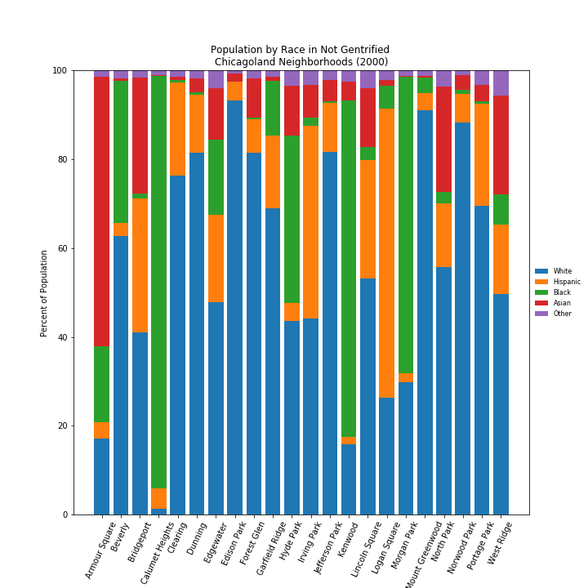
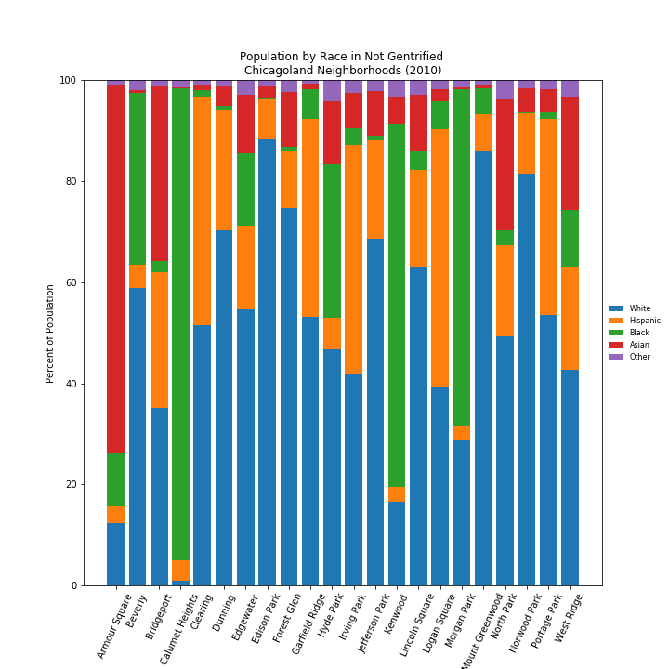
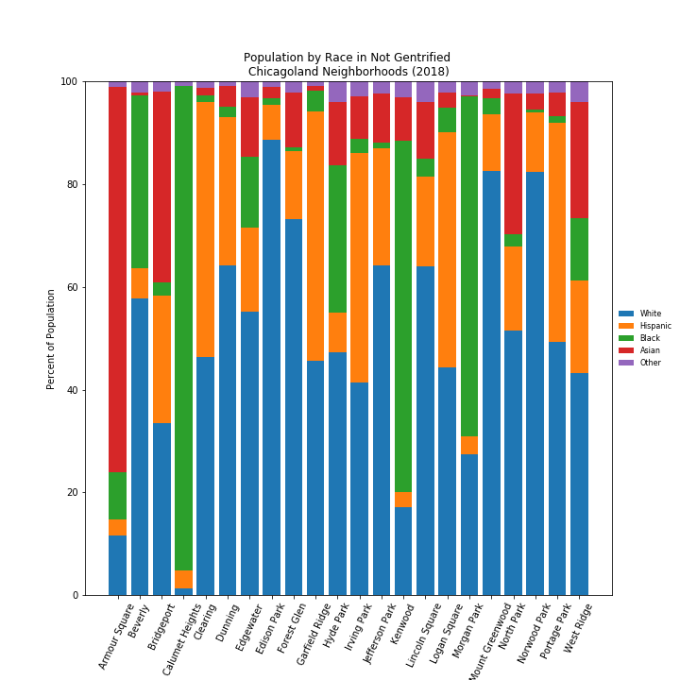
Changes in Racial Makeup
of Non-Gentrified Neighborhoods
Notes:
Non consistent patterns over time
In many, white populations decrease, but not in all

Slide 8
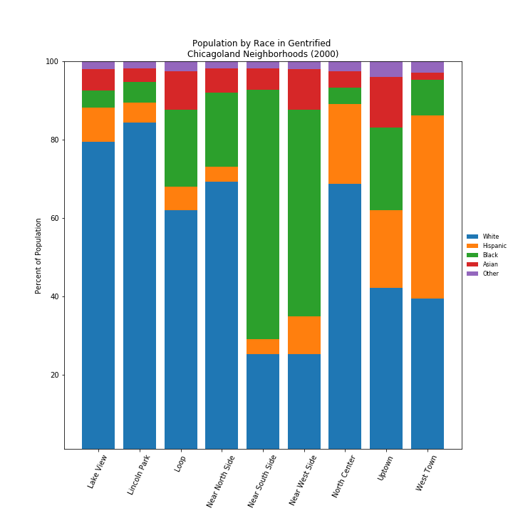
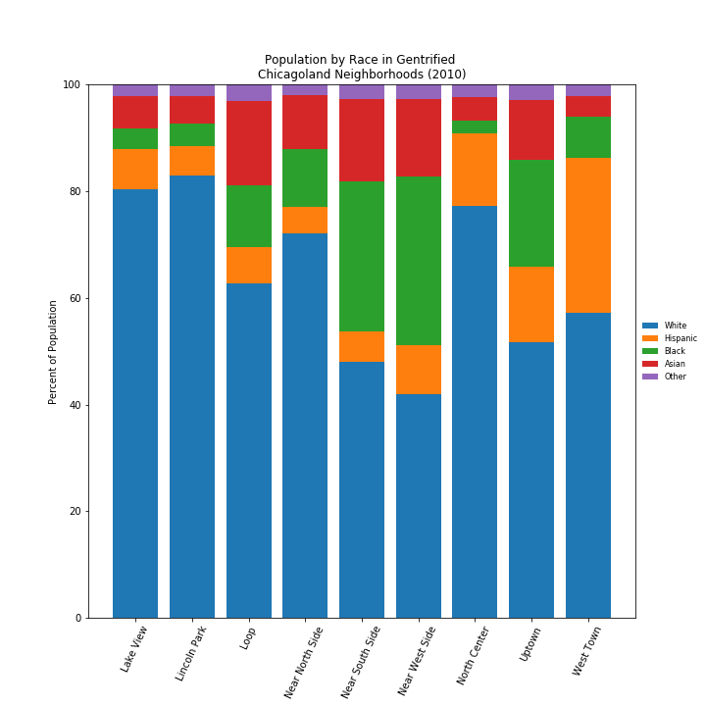
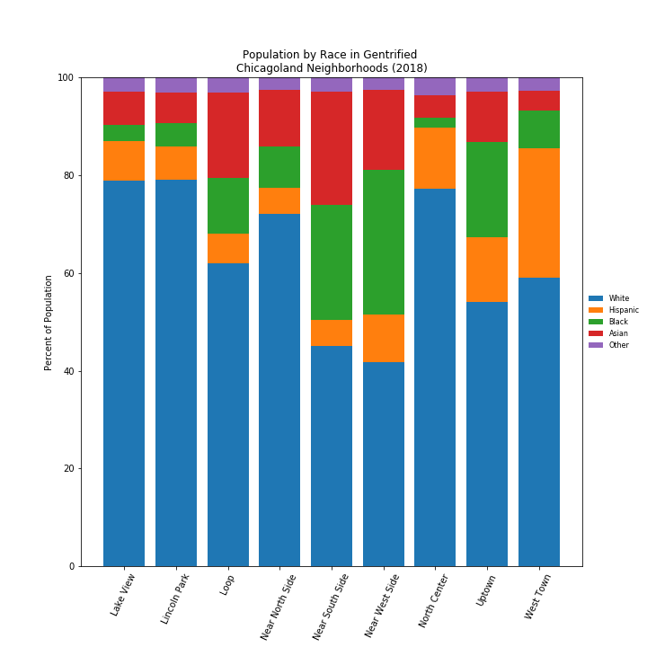
Changes in Racial Makeup
of Gentrified Neighborhoods

Slide 9
Crime Changes
Do patterns in criminal behavior change with gentrification?

Slide 10



City of Chicago Data: Crime Records
Perform an API call on 1.2m Crime Records [‘02, ‘10, ‘18]
400k / yr, maxes out ChiData.freeuser
Could loop through lat/long for CCA under observation (30)
A series of data transformations to collect RefIDs
[ Merge, Drop, Groupby, Unstack, ‘Math’, iloc, Melt, Rename ]
Generate Boxplots
Plotted By:
Neighborhood type [‘Gentrified’, ‘Nongentrified’]
FBI Crime Index [‘Nonviolent’, ‘Violent’, ‘White Collar’]
Year [ ‘2002 est’, 2010, 2018]
Crime, FBI Crime index, Population, Neighborhood Name, UIC Gent Index
Final set is about

Slide 11
City of Chicago Data: Crime Records
H1: As neighborhoods gentrify, violent crime and nonviolent crime will decrease.
H2: Since gentrification follows White migration and wealth, as neighborhoods gentrify, White Collar crimes will increase.
HØ: Gentrification does not have an effect on crime rate.

Slide 12
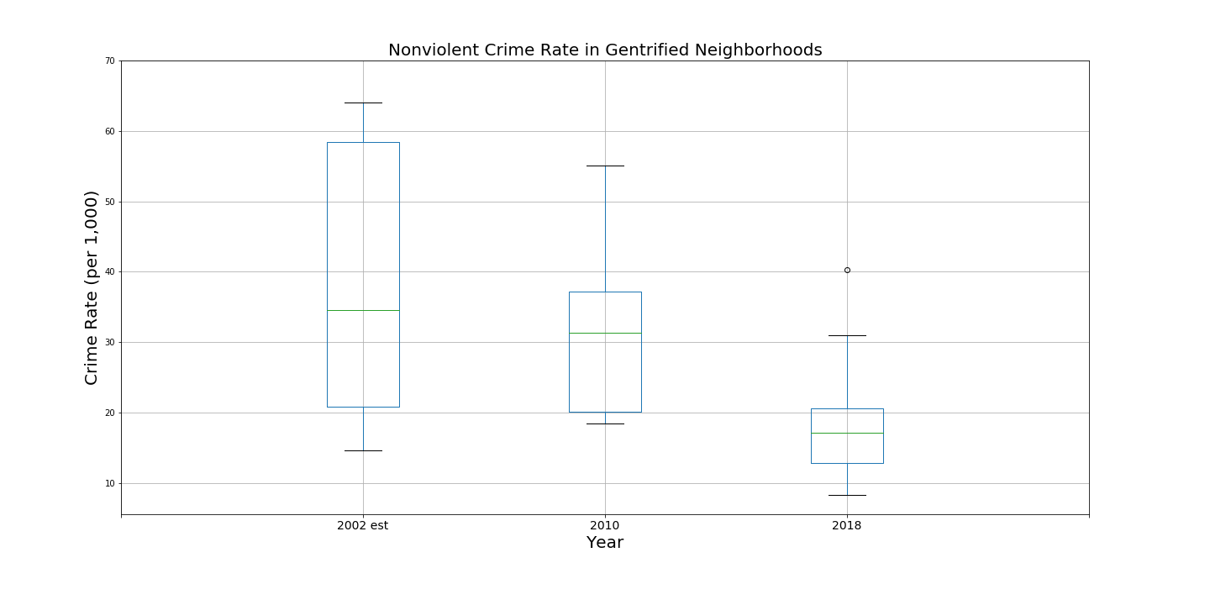

Slide 13
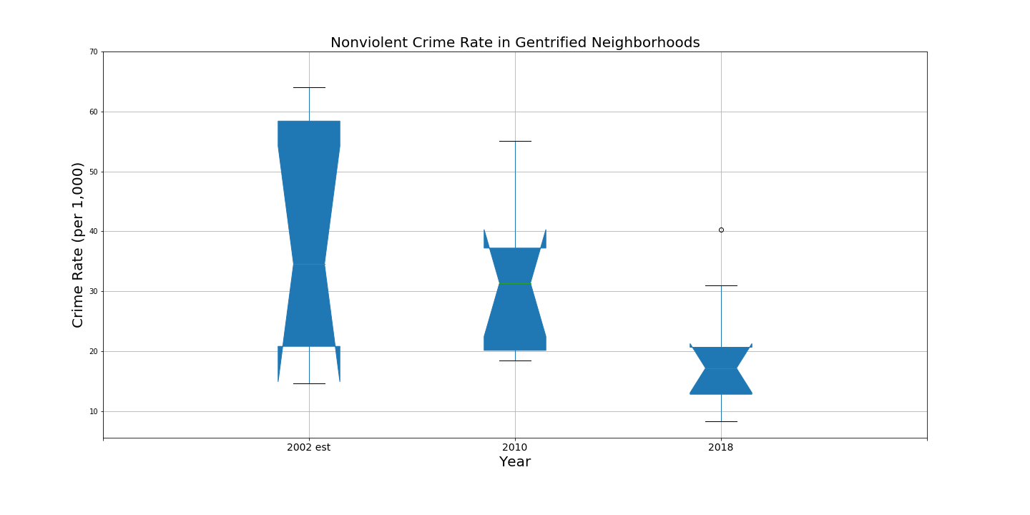

Slide 15
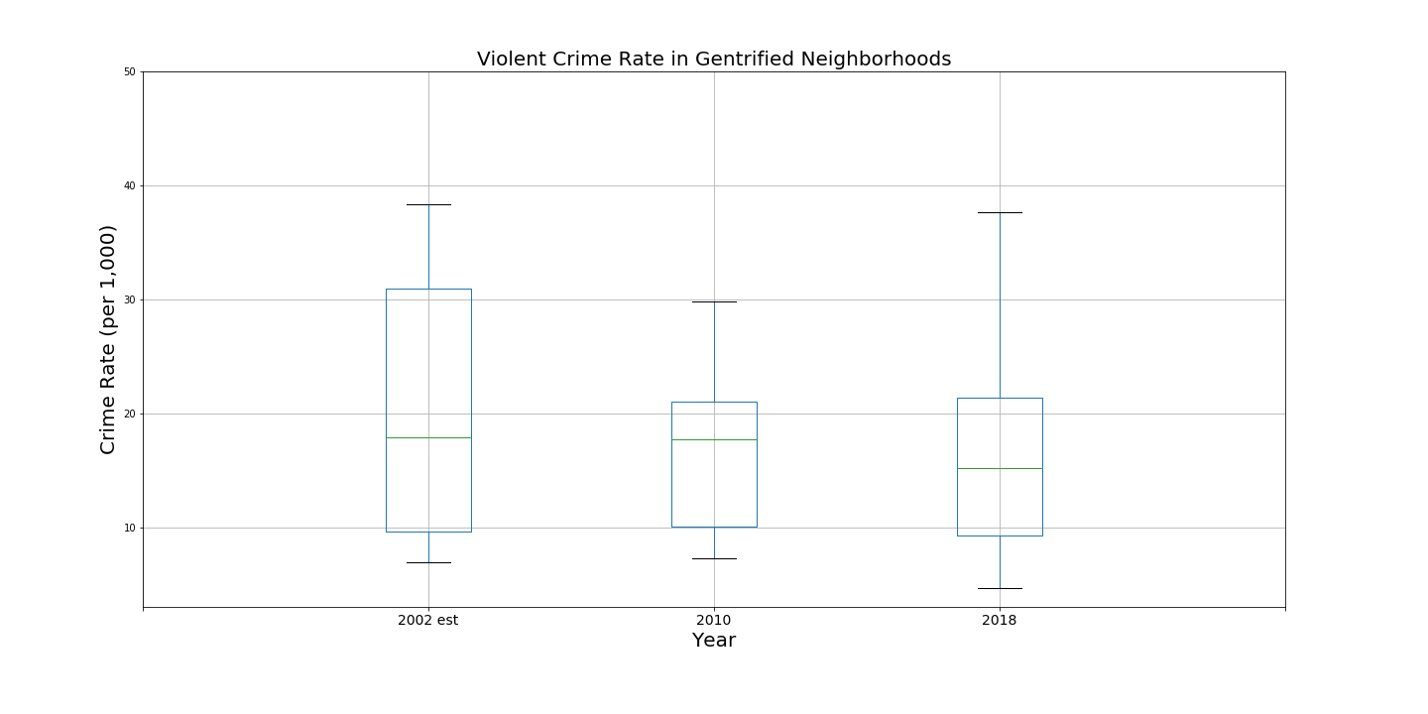
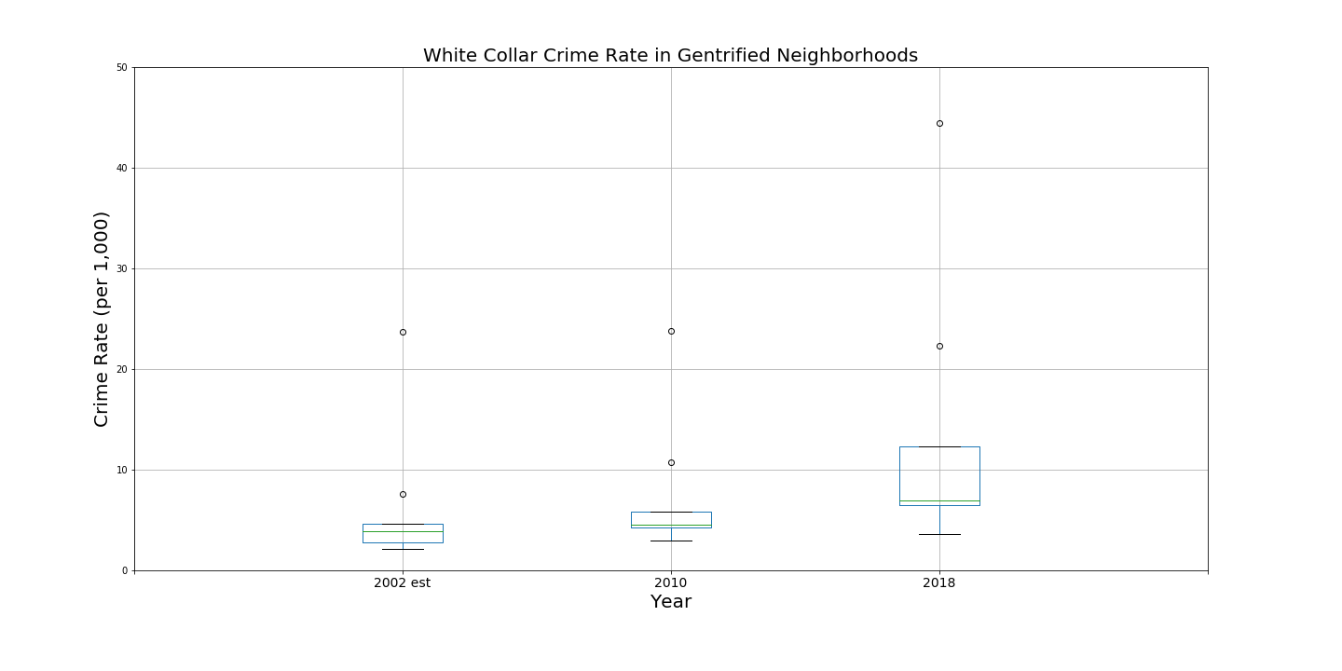
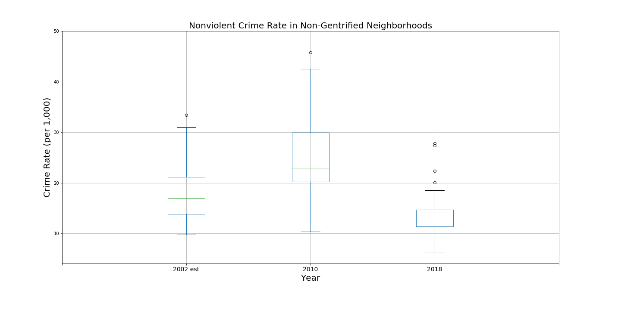
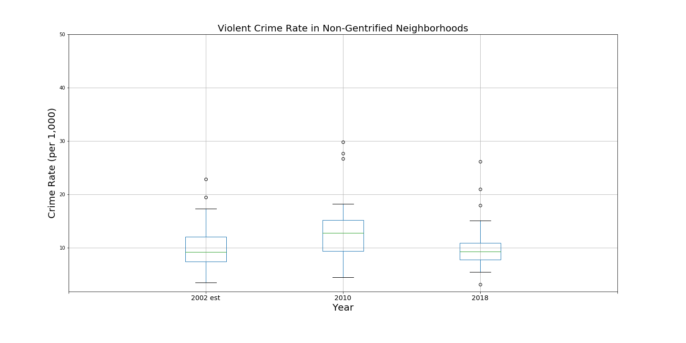
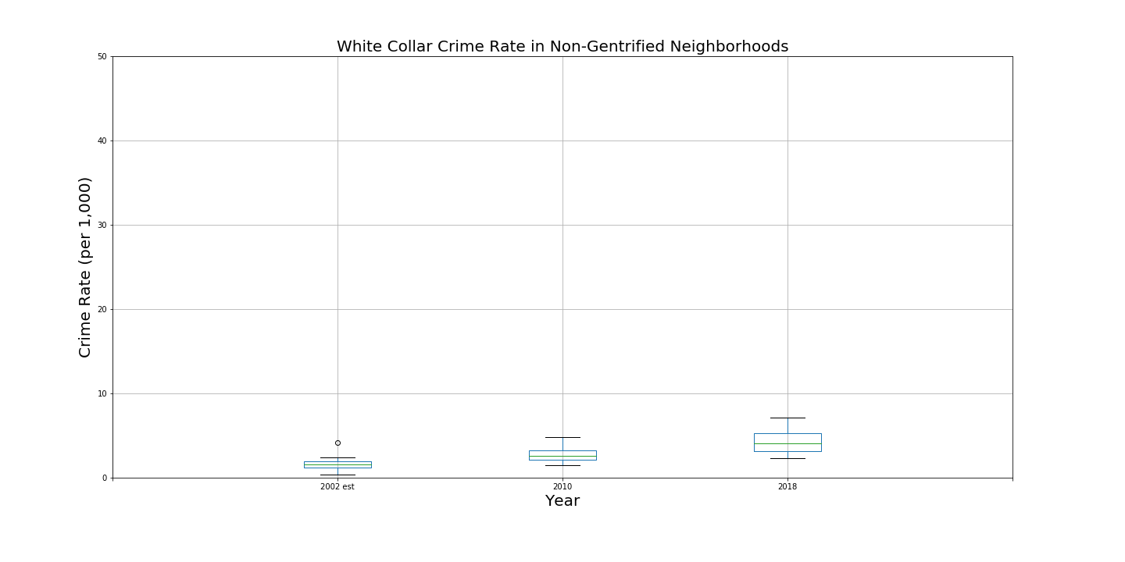
 | Non-Violent |  |  | Violent |  |  | White Collar
F-Statistic:
3.581308
P-Value:
0.043544*
F-Statistic:
0.269501
P-Value:
0.766041
F-Statistic:
1.533251
P-Value:
0.236238
Gentrified
F-Statistic:
12.08305
P-Value:
0.000036***
F-Statistic:
2.670908
P-Value:
0.07701974
F-Statistic:
33.416747
P-Value:
0.00000***
Not Gentrified
Notes:
Non-violent gentrified seems to be a real trend downward
Interesting to note the high p-value and mean of violent gentrified
Increase in white collar across the board
But the not gentrifying neighborhoods seem to have something else going on - 2010 was a very complicated year

Slide 16
 | Non-Violent |  |  | Violent |  |  | White Collar
F-Statistic:
3.581308
P-Value:
0.043544*
F-Statistic:
0.269501
P-Value:
0.766041
F-Statistic:
1.533251
P-Value:
0.236238
Gentrified
F-Statistic:
12.08305
P-Value:
0.000036***
F-Statistic:
2.670908
P-Value:
0.07701974
F-Statistic:
33.416747
P-Value:
0.00000***
Not Gentrified
Notes:
Non-violent gentrified seems to be a real trend downward
Interesting to note the high p-value and mean of violent gentrified
Increase in white collar across the board
But the not gentrifying neighborhoods seem to have something else going on - 2010 was a very complicated year

Slide 17
 | Gentrified | Not Gentrified
Nonviolent | 37.24 | 18.78 | 2002
 | 32.52 | 25.72 | 2010
 | 19.37 | 14.22 | 2018
Total ∆ | -17.88 | -4.56
Violent | 20.05 | 10.25 | 2002
 | 17.79 | 13.80 | 2010
 | 16.64 | 10.57 | 2018
Total ∆ | -3.42 | 0.32
White Collar | 6.07 | 1.63 | 2002
 | 7.38 | 2.83 | 2010
 | 13.25 | 4.33 | 2018
Total ∆ | 7.17 | 2.70

